Slide 1
2016 Open Enrollment
Partner Benefit Highlights
November 9 – 24, 2015

Slide 2
Agenda
Introduction – Upcoming Plan Year
Benefit Overviews
Medical
Health Savings Account
Dental
Vision
Basic Life Insurance and AD&D
Voluntary Life and AD&D
Long Term Disability
Employee Assistance Provider
Other Firm Benefits
How to Enroll

Slide 3
Introduction
Open Enrollment for the 2016 benefits will run from November 9th – 24th
Elections or changes you make will become effective on January 1, 2016 and will go through December 31st, 2016. Changes can only be made during the year with a qualifying event
Benefits available include:
Medical – Blue Cross/Blue Shield of Illinois HSA Account – HSA Bank Basic Life Insurance and AD&D – Standard Employee Assistance Provider (EAP) – Standard through BDA network Additional Voluntary products - AFLAC | Dental – Delta Dental Voluntary Vision – VSP Voluntary Life and AD&D – Standard Long Term Disability (LTD) – Standard Long-Term Care – Genworth

Slide 4
Benefit Overviews Medical – BlueCross Blue Shield of Illinois
As of January 1, 2016, your medical plans are no longer “grandfathered health plans” under the Patient Protection and Affordable Care Act (the Affordable Care Act). As a result of this the following changes will be seen in your 2016 medical plans:
Preventative care will now be covered at 100% with no copay requirement
The out-of-pocket maximum includes deductible and copays (including Rx) for in-network benefits

Slide 5
Benefit Overviews Medical – Plan Option Comparison
 | BASE PLAN |  | HSA PLAN
 | In Network | Out of Network | In Network | Out of Network
Deductible | $1,000 / $2,000 | $2,000 / $5,000 | $2,000 / $4,000 (True Family) | $4,000 / $8,000
OOP Max (including ded) | $3,000 / $6,000 | $8,000 / $15,000 | $4,000 / $6,850 (True Family) | $8,000 / $16,000
Coinsurance | 20% | 40% | 20% | 40%
Office Visits
Preventive | Free | 40% | Free | 40%
Primary Care | $25 | Ded & 40% | Ded & 20% | Ded & 40%
Specialist | $40 | Ded & 40% | Ded & 20% | Ded & 40%
Inpatient Hospital | Ded & 20% | $250, Ded & 40% | Ded & 20% | $250, Ded & 40%
Outpatient Hospital | Ded & 20% | Ded & 40% | Ded & 20% | Ded & 40%
Emergency Room | $100*, 20% | $100*, 20% | Ded & 20% | Ded & 20%
Prescription Drug
Retail – Generic / Formulary / Non-Formulary | $15 / $35 / $50 | Copays + 25% coinsurance | Ded then $15 / $35 / $50 | Deductible, then copays + 25% coinsurance
Mail Order – Generic / Formulary / Non-Formulary | $37.50 / $87.50 / $125 | No coverage | Ded then $37.50 / $87.50 / $125 | No coverage
Those enrolled in the Buy-Up PPO Plan will be moved to the Base PPO Plan unless you make another election during OE

Slide 6
What should you consider when deciding on your medical plan?
1
Provider availability Will you be able to visit the doctors, hospitals and other facilities you want to?
Your costs What is going to come out of your paycheck every month? What about for the whole year?
Benefit payments How much you will have to pay out of your pocket for your medical expenses?
Medical services Consider your health status and services you expect to consume during the year. What has your experience been in past years?
2
3
4

Slide 7
How does the HSA work?
A special, tax-advantaged savings account offered only to participants in the High Deductible option
Use your HSA to offset out-of-pocket health care costs this year — or save it for the future
You cannot be covered by another health plan including FSA, Medicare or Tricare to qualify to make an HSA contribution
Key features of the HSA include:
A triple tax advantage. HSA money is tax-free when it enters the plan, when it grows through investment earnings and remains tax-free when it is withdrawn — as long as you use it to pay eligible health care expenses. For a list of eligible health care expenses, go to www.irs.gov.
Immediate ownership. All contributions to your HSA are immediately yours to keep
No risk of forfeiture. Unused amounts at the end of a plan year roll over to the next year. Unlike FSAs, there is no “use it or lose it” rule.
Portability. If you change plans, retire or leave Locke Lord for any reason, you keep your account balance

Slide 8
BCBSIL HDHP/HSA Example
Illustration using $2,000 individual plan deductible and $2,000 voluntary contribution to HSA
Preventive care
Routine physical $ 250 Paid by Health Coverage at 100%
Health Coverage 100% / 80%
Non-preventive care
Prescriptions $ 250
Urgent care visit 100
Physician’s visit 125
Total $ 475
Member Responsibility
$2,000
Preventive Care
Ded. $2,000
HSA
$900
Paid with
HSA $ 475
$475 Expenses
$1525 Rollover
Rollover
To Year Two $ 1525

Slide 9
Benefit Overviews Health Savings Account (HSA) HSA Bank
Administered by HSA Bank – www.hsabank.com
Fund your HSA account through payroll deductions
The Member Website gives you 24/7 online access to manage your account. :
Setting up direct deposit
Updating your profile
Checking your balance and account activity
Ordering additional debit cards
You can also manage your account through HSA Bank’s mobile app
Annual contribution limit for 2016
$3,350 for individual
$6,750 for family
Catch up (age 55 or older) – additional $1,000

Slide 10
Doctor on demand
A next-generation video telemedicine company, offering on-demand and scheduled video consultations with US-licensed physicians, psychologists, and lactation consultants
Within just a few minutes, employees are able to sign up and connect to a US-licensed provider for a live video telemedicine visit. The average wait time to connect to an urgent care physician is 90 seconds
No PEPM charge to Locke Lord
No administrative, implementation, marketing or integration fees for Locke Lord
Costs of our video visits (starting in 2016, BCBSIL will take as a claim):
Primary/Urgent Care: $40 for 15 minutes
Behavioral/Mental Health: $50 for 25 minutes, $95 for 50 minutes
Lactation Consulting: $40 for 25 minutes, $70 for 50 minutes (Unable to subsidize)
Common issues: cough, cold, flu, rash, pink eye, sports injury, bites, sore throat, depression, anxiety, etc.

Slide 11
Pharmacy cost savings through drug management
Step Therapy
Specialty medications only and new drug therapies
Members will be grandfathered members if they are currently using a drug that is on the step therapy list
The goal of the program is to help both members and the plan see savings by using more cost-effective drugs, such as generics or less expensive brand name drugs, before trying the most expensive brand name drug option
Prime Therapeutics Specialty Pharmacy
877-627-MEDS (6337)
Support for members who need specialty medication for such conditions as cancer, Hepatitis C, Multiple Sclerosis or Rheumatoid Arthritis

Slide 12
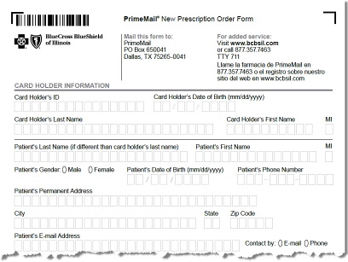
Home Delivery Prescriptions
Pre-register online at bcbsil.com
Or, call PrimeMail at 1-877-357-7463 and pre-register by phone
Download forms for new prescriptions and have your physician fax directly from his or her office
Or, obtain new prescriptions from your doctor and mail them along with the order form to PrimeMail

Slide 13
Partner Premiums Effective January 1, 2016
Medical Monthly Rates | Base Plan | HSA Plan
Individual Only | $721.12 | $610.30
Individual & Spouse | $1,391.77 | $1,177.88
Individual & Child(ren) | $1,341.26 | $1,135.14
Individual & Family | $2,069.61 | $1,751.56

Slide 14
Online Tools, Resources and Programs

Slide 15
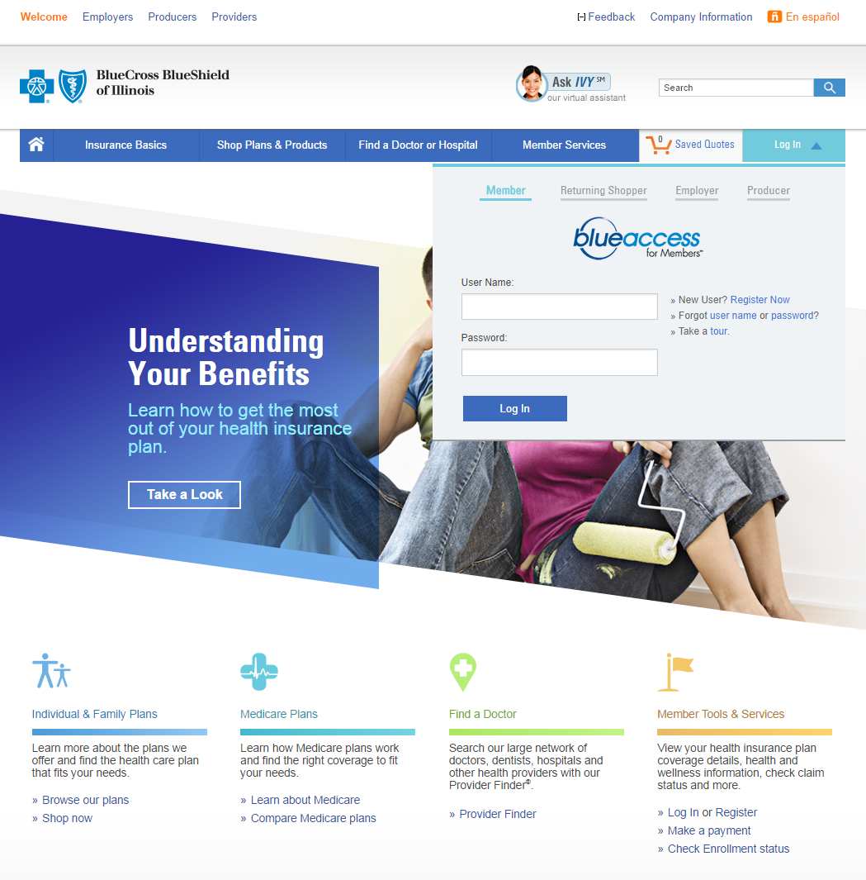
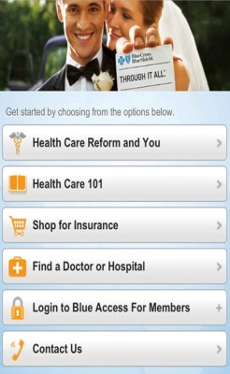
Register for Blue Access for MembersSM
Go to bcbsil.com via web or mobile
Or click Register Now for New Users
To register you will need your ID number
(1) on the back your ID card, OR (2) call Customer Service

Slide 16
How to Find a Provider
Call Customer Service on the back of your ID card 888-979-4516
Call BlueCard® Access – available 24/7 800-810-BLUE (-2583)
From your computer OR mobile phone, log on to bcbsil.com and click on ‘Provider Finder’
OR talk with your physician’s office

Slide 17
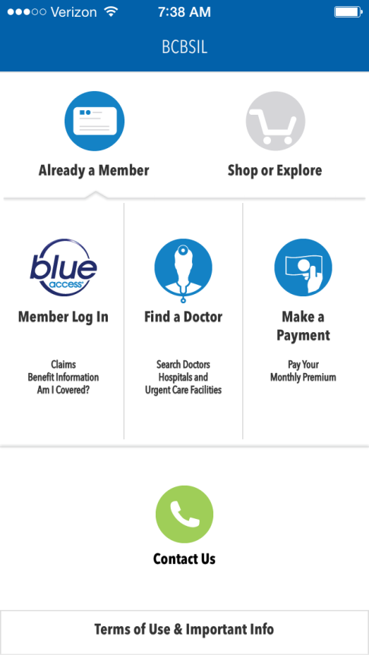
BCBSIL App
Find a doctor, hospital or urgent care facility
Search for doctors that speak Spanish
Log in to Blue Access for MembersSM
View claims and coverage details
Create / view messages from customer service
Access or request ID cards
Access health and wellness information
Link to map and directions
To download the app, go to Google Play, the App Store or text “BCBSILAPP” to 33633

Slide 18
Service that Takes You Out of the Middle
Call your BCBS customer service team for:
Claim questions or status
Medical benefit coverage questions
Help with finding network providers
Help with navigating BCBSIL online tools
ID card requests
Health education and transfer to other health programs
Transition of care
888-979-4516

Slide 19
Benefit Overviews – Delta Dental TX
Delta Dental PPO Plan
Eligibility | Primary enrollee, spouse & eligible dependent to age 28
Deductibles | $50 per person / $150 per family each calendar year
Maximums | $5,000 per person each calendar year
Diagnostic & Preventative Services (D&P) Exams, cleanings, x-rays & sealants | 100% (deductible waived)
Basic Services Fillings & simple tooth extractions | 80%
Endodontics (root canals) Covered under Basic Services | 80%
Periodontics (gum treatment) Covered under Basic Services | 80%
Oral Surgery Covered under Basic Services | 80%
Major Services Crowns, inlays, onlays & case restorations | 50%
Prosthodontics Bridges, dentures & implants | 50%
Orthodontic Benefits Adults & dependent children | 50%
Orthodontic Maximum | $5,000 Lifetime
You can visit any licensed dentist under this plan, but you’ll maximize plan value by selecting a Delta Dental PPO dentist.
PPO network dentists have agreed to reduced contracted rates and can’t “balance bill” you for additional fees.
Find a dentist at deltadentalins.com
Partners do not have to enroll in the dental plan in 2016

Slide 20
Partner Premiums Effective January 1, 2016
Dental Monthly Rates | PPO Plan
Individual Only | $51.20
Individual & Spouse | $93.01
Individual & Child(ren) | $112.26
Individual & Family | $150.64

Slide 21
Benefit Overviews Vision - VSP
Benefit | Description | Copay | Frequency
WellVision Exam | Focuses on your eyes and overall wellness | $10 | Every calendar year
Prescription Glasses |  | $20 | See frame & lenses
Frame | $150 allowance | Included | Every other calendar year
Lenses | Single vision, lined bifocal, lined trifocal lenses & Polycarbonate lenses for dependent children | Included | Every other calendar year
Lens Options | • Standard progressive lenses • Premium progressive lenses • Custom progressive lenses • Average 35-40% off other lens options | $50 $80 - $90 $120 - $160 | Every calendar year
Contacts (instead of glasses) | $150 allowance; 15% off contact lens exam | $0 | Every calendar year
Diabetic Eyecare Plus Program | Services related to diabetic eye disease, glaucoma and age-related macular degeneration (AMD). Retinal screening for eligible members with diabetes. Limitations and coordination with medical coverage may apply. Ask your VSP doctor for details. | $20 | As needed
Extra Savings & Discounts | Additional Glasses & Sunglasses - 30% off Laser Vision Correction - Average 15% off the regular price or 5% off the promotional price
VSP is one of the nation’s leading vision service plans with national network of providers.
You can find a provider on line at vsp.com or you can call 800-877-7195
Visit vsp.com for coverage details if you plan to see a provider other than a VSP doctor.

Slide 22
Partner Premiums Effective January 1, 2016
Vision Monthly Rates | Voluntary
Individual Only | $7.73
Individual & Spouse | $15.48
Individual & Child(ren) | $16.55
Individual & Family | $26.46

Slide 23
Benefit Overviews Basic Life and AD&D Insurance – The Standard
Under the Locke Lord plan, life insurance is a mandatory partner plan
Partners are auto enrolled in Term Life and AD&D coverage at $1 Million
Like all benefits Partners are responsible for the premiums
No Medical Underwriting

Slide 24
Benefit Overviews Voluntary Life Insurance – The Standard
Obtain up to $700,000 or 5X your compensation in increments of $10,000
Spouse Life up to $500,000 (spousal life coverage cannot exceed your voluntary life election)
Child life up to $10,000
Must elect Voluntary Life in order to obtain Spousal Life
Increasing your coverage amount
Voluntary AD&D is available in increments of $50,000 up to $500,000 for either individual or family coverage
Currently enrolled, you will have a one-time open enrollment option to increase your benefit up to the Guarantee Issue (GI) amount
$200,000 for individual coverage
$50,000 for spousal coverage
$10,000 for child coverage
Late enrollees have a one-time open enrollment to enroll for
$10,000 for individual coverage
$5,000 for spousal coverage
$2,000 for child coverage

Slide 25
Benefit Overviews Long Term Disability – The Standard
LTD coverage – 60% of compensation (prior year’s K-1 earnings)
Partners maximum benefit of $25,000 per month
The elimination period is 90 days
EAP benefit provided through the disability plan

Slide 26
Benefit Overviews Employee Assistance Program (EAP)
Confidential service available 24/7 to help you and all of your family members with almost any issue
Counseling available face-to-face, via telephone, or computer – Up to three (3) sessions at no cost
Counseling for self-help, family or child issues
Relationship Counseling
Workplace Issues
Healthy Living
Elder Care
Managing Finances
Call 888-293-6948 or visit www.eapbda.com
Username: standard / Password: eap4u

Slide 27
AFLAC Programs
Additional coverage available through
Accident Coverage
Cancer Coverage
Hospital Intensive Care Protection
Critical Care and Recovery
To enroll, go to www.aflac.com/lockelord
Choose your state
Username: your SSN
Password: last 4 numbers of your SSN and first letter of your last name

Slide 28
CHUBB – GROUP PERSONAL UMBRELLA INSURANCE PROGRAM
The new Group Personal Umbrella Insurance Program provides liability coverage for personal injury, bodily injury, or property damages you or a covered family member are liable for in excess of required underlying limits provided under your primary policies.
The following options are available under this policy:
Excess Liability from $1 million to $25 million of coverage
Excess Uninsured/Underinsured Motorist from $1 million to $5 million
Employment Practices Liability
An overview of these options and the application form with annual premium information can be found on the LL Benefits Page of the LNET. If you elect to join this plan, annual premiums must be paid via payroll deductions in January 2016. Policy will be in effect from January 1 to December 31, 2016. Annual renewal is required. This plan is not portable/convertible.
All application forms must be returned to Human Resources by December 11, 2015.

Slide 29
Other Firm Benefits
Business Travel Accident (BTA) Insurance – ACE
Long-term Care – Genworth
Back-Up Child/Adult Care – Bright Horizons/Care.com
Discount programs
Please see the Locke Lord Benefit page located on the LNET for more details.

Slide 30
How to Enroll in the Health and Welfare Benefits
To enroll in your benefits:
Legacy EW Partners and employees will use Workday: https://www.myworkday.com/lockelord/login.flex
Link to Workday is located under Firm Resources in LNET
All other Partners and employees will use the ADP portal: https://portal.adp.com/public/index.htm
Link to ADP Portal is located in “My Info” box on the Home page in LNET
Plan year runs from January 1 to December 31, so elections you will be making are effective until December 31, 2016.
If you choose to opt out of coverage, you will not be eligible for that plan until the next open enrollment period in November 2016. However, you will be permitted to make a benefit election change if you experience a family status change such as the birth of a child, marriage, divorce, spouse losing coverage, etc. within 30 days of the life status change.

Slide 31
Questions?
Attorney Advertising.
Locke Lord LLP disclaims all liability whatsoever in relation to any materials or information provided. This presentation is provided solely for educational and informational purposes. It is not intended to constitute legal advice or to create an attorney-client relationship. If you wish to secure legal advice specific to your enterprise and circumstances in connection with any of the topics addressed we encourage you to engage counsel of your choice. © 2015 Locke Lord LLP

